Slide 1

An Efficient Search Method For Encrypted Cloud Data
Using Feature To Match Joint Keyword
Presented By Batch-A5
1. G. Naga Lakshmi 20481A1256 3. B. Archana 21485A1203 2. G. Dinesh Kumar 20481A1254 4. B. Sravanthi 20481A1213
Under the guidance of
Sri Y.K.Viswanadham M.Tech.,(Ph.D.,)
Associate Professor
Department of Information Technology SESHADRI RAO GUDLAVALLERU ENGINEERING COLLEGE (An Autonomous Institute with Permanent Affiliation to JNTUK, Kakinada) Seshadri Rao Knowledge Village, Gudlavalleru – 521356, Andhra Pradesh

Slide 2
OUTLINE
Abstract
Introduction
Problem Definition
Objectives
Existing System
Limitations / Disadvantages
Proposed System
Proposed System Block Diagram
System Design
References

Slide 3
ABSTRACT
With the continuous improvement of the security of cloud storage, more users upload private data to the cloud.
However, a large number of encrypted data using independent keywords to create indexes not only directly increase the storage overhead, but also lead to the decline of search efficiency.
Therefore, this proposes an efficient search method using features to match joint keywords (FMJK) on encrypted cloud data.
This method proposes that each d keywords are randomly selected from the non-duplicated keywords
which are extracted from the documents of the data owner, to generate a joint keyword, and all joint keywords form a keyword dictionary.

Slide 4
Each joint keyword is matched with the feature of the document and the query keyword respectively.
The result obtained by the former is regarded as a dimension of the document index, while the result obtained by the latter is regarded as a dimension of the query trapdoor.
Finally, the BM25 algorithm is used to calculate the inner product of the document index and the trapdoor, and then sort them and the top k results are returned.
This project introduces a novel approach that enables effective search operations on encrypted cloud data while preserving data privacy.
By utilizing feature extraction and joint keyword matching, the proposed method enhances the search process, ensuring data security remains uncompromised.

Slide 5
INTRODUCTION
With the rapid development of science and technology, enterprises or individual users increasingly rely on storing a large number of data documents on cloud servers in order to share data quickly and remotely.
However, with the increasing demand, the cost of cloud server storage increases, the efficiency of search decreases, and privacy protection has become a focus .
This project seeks to overcome this limitation by presenting an innovative method that enables efficient keyword-based searches on encrypted cloud data, maintaining data security without the need for full decryption.

Slide 6
PROBLEM DEFINITION
In the landscape of modern data management, cloud computing has emerged as a pivotal technology, providing vast storage capabilities and on-demand access.
However, this convenience brings forth significant concerns regarding data security and privacy.
Traditional search methods require decryption, compromising privacy.
Current search methods lack the ability to provide accurate keyword matching for encrypted data.

Slide 7
Traditional search algorithms were not designed to operate on encrypted content, leading to suboptimal search results and potentially hampering critical decision-making processes .

Slide 8
OBJECTIVES
Develop an innovative approach for conducting efficient searches on encrypted cloud data.
Implement feature extraction techniques to enable keyword matching without full decryption.
Enable joint keyword matching to enhance search accuracy.
Maintain data security and privacy throughout the search process.

Slide 9
EXISTING SYSTEM
In most of the existing cipher-text sorting retrieval methods, KNN (K Nearest Neighbor) technology is used to create indexes supporting cipher-text retrieval .
In the process of massive data encryption search, most of the search encryption schemes have high time complexity and large storage space.
which are closely related to the encrypted key, the document index and query request dimensions .

Slide 10
LIMITATIONS
Traditional decryption-based search methods are inefficient and time-consuming.
Decryption during search compromises data privacy.
Current methods lack accuracy in keyword matching for encrypted data.

Slide 11
PROPOSED SYSTEM
Our proposed system aims to overcome the limitations of already existing cipher-text sorting retrieval methods.
we propose an efficient search method using features to match joint keywords (FMJK) on encrypted cloud data based on the MRSE (Privacy-Preserving Multi-Keyword Ranked Search over Encrypted Cloud Data) scheme.

Slide 12
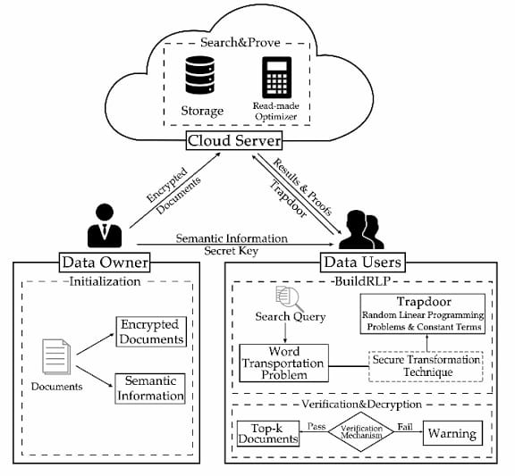
PROPOSED SYSTEM BLOCK DIAGRAM

Slide 13
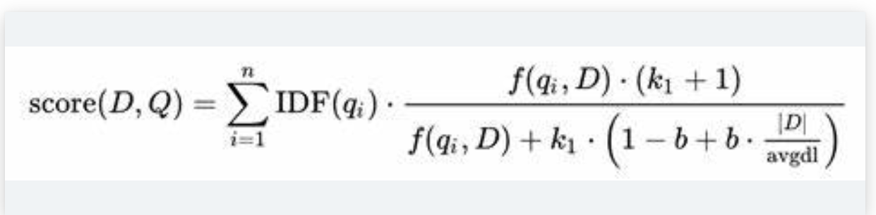
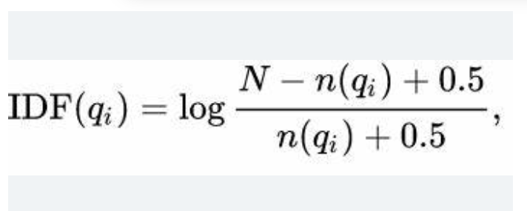
BM25: Formula

Slide 14
In information retrieval, Okapi BM25 (BM is an abbreviation of best matching) is a ranking function used by search engines to estimate the relevance of documents to a given search query.
It is based on the probabilistic retrieval framework developed in the 1970s and 1980s.
Key Components :
1.Term Frequency : TF refers to the number of times a particular term appears in a document. However, BM25 uses a modified term frequency that takes into account saturation effects to prevent overemphasizing heavily repeated terms.

Slide 15
2.Inverse Document Frequency (IDF): IDF measures the importance of a term in the entire corpus. It assigns higher weights to terms that are rare in the corpus and lower weights to terms that are common. IDF is calculated using the formula: IDF = log((N — n + 0.5) / (n + 0.5)), where N is the total number of documents and n is the number of documents containing the term.
3. Document Length Normalization: BM25 incorporates document length normalization to address the impact of document length on relevance scoring.

Slide 16
Longer documents tend to have more occurrences of a term, leading to potential bias. Document length normalization counteracts this bias by dividing the term frequency by the document’s length and applying a normalization factor.
4.Query Term Saturation: BM25 also includes a term saturation function to mitigate the impact of excessively high term frequencies. This function reduces the effect of extremely high term frequencies on relevance scoring, as very high frequencies often correspond to less informative terms.

Slide 17
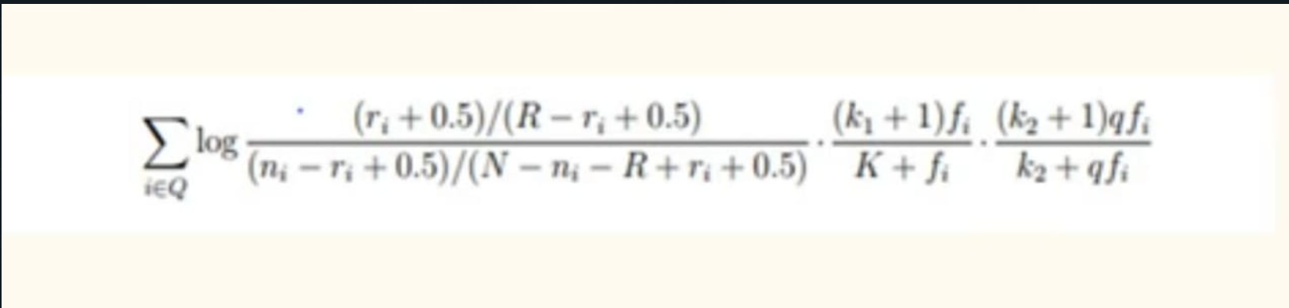
There are some variations of the scoring function for BM25, the most common form is:
Where:
ri is the number of relevant documents containing term i,
ni is the number of documents containing term i
N is the total number of documents in the collection
R is the number of relevant documents for this query
r and R are set to zero if there is no relevance information
fi is the frequency of term i in the document
qfi is the frequency of term i in the query;
k1,k2, and K are parameters whose values are set empirically.

Slide 18
fi is the frequency of term i in the document
qfi is the frequency of term i in the query;
k1,k2, and K are parameters whose values are set empirically.

Slide 19
Software Requirements:
Development Language: Python
Encryption Libraries.
Keyword matching algorithm: BM25
Cloud Services : AWS
Hardware Requirements:
Operating System :windows 7 or 7+
Ram : 8 GB
Hard Disc or SSD : More than 256 GB
Processor : Intel 3rd generation or high

Slide 20
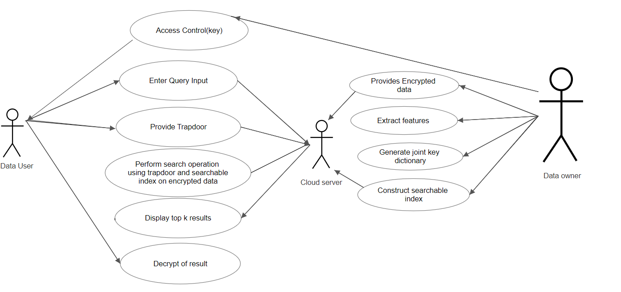
System Design
Usecase diagram:
An Efficient Search Method For Encrypted Cloud Data
Using Feature To Match Joint Keyword

Slide 21
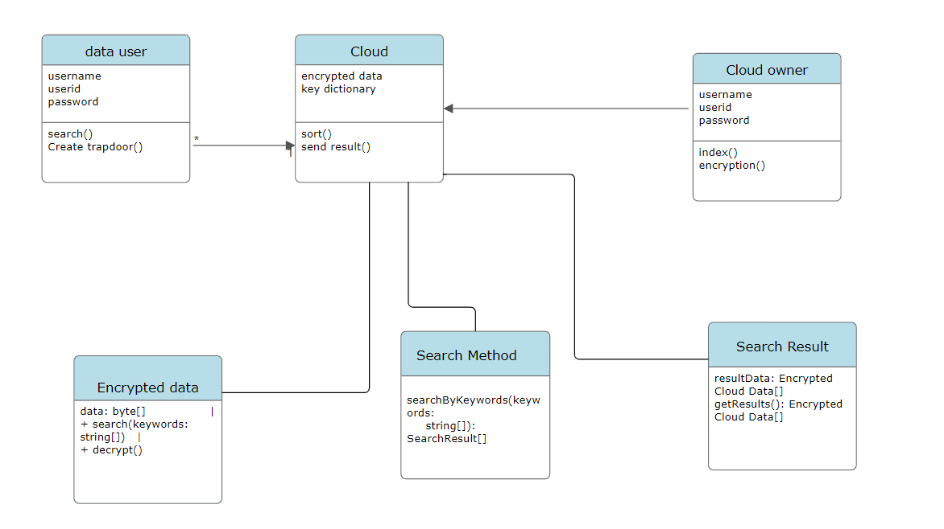
System Design
Class Diagram:
An Efficient Search Method For Encrypted Cloud Data
Using Feature To Match Joint Keyword

Slide 22
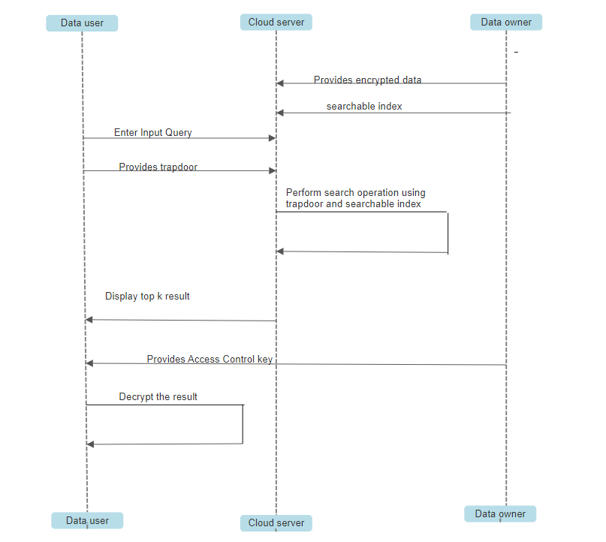
SYSTEM DESIGN
Sequence diagram:
An Efficient Search Method For Encrypted Cloud Data
Using Feature To Match Joint Keyword

Slide 23
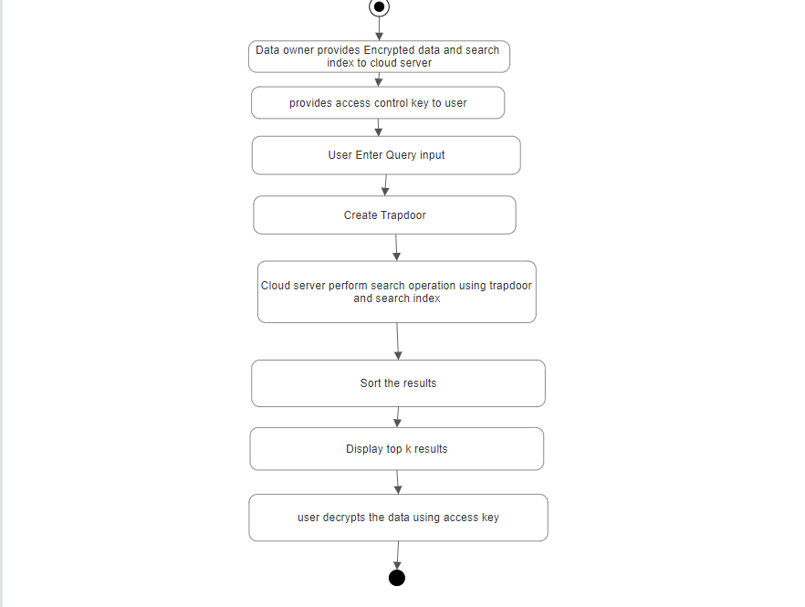
System Design
Activity Diagram:
An Efficient Search Method For Encrypted Cloud Data
Using Feature To Match Joint Keyword

Slide 24
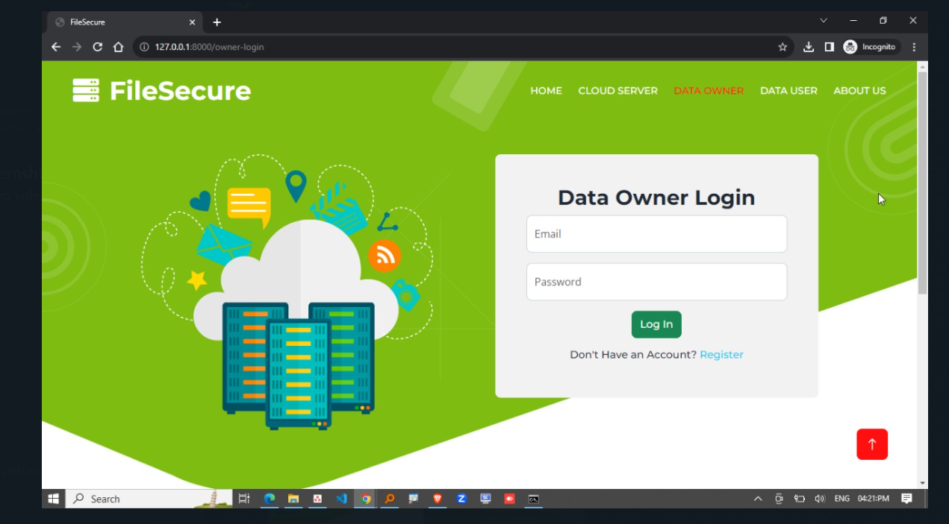

Slide 25
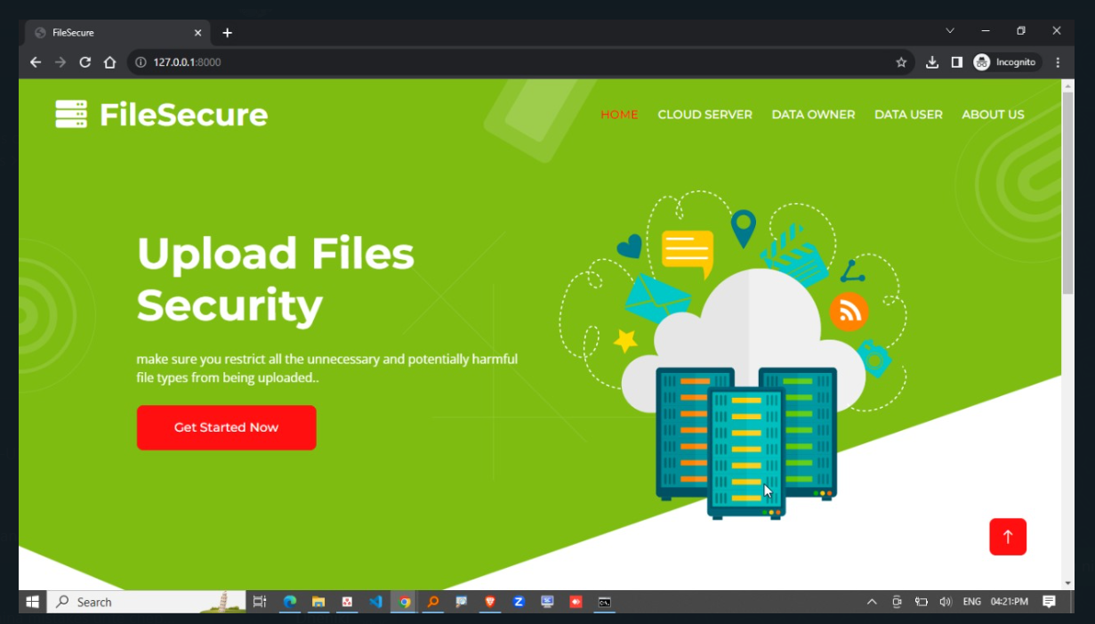

Slide 26
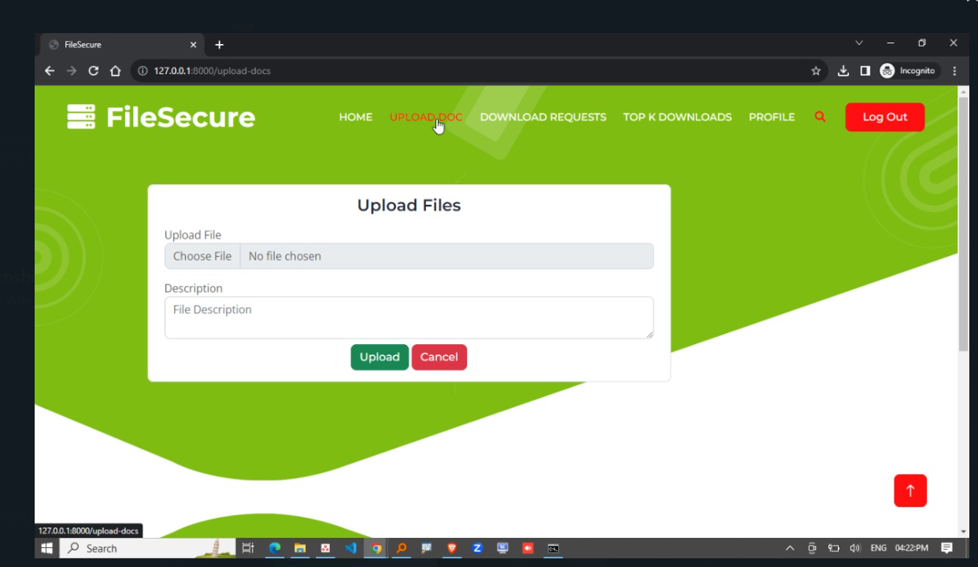

Slide 27
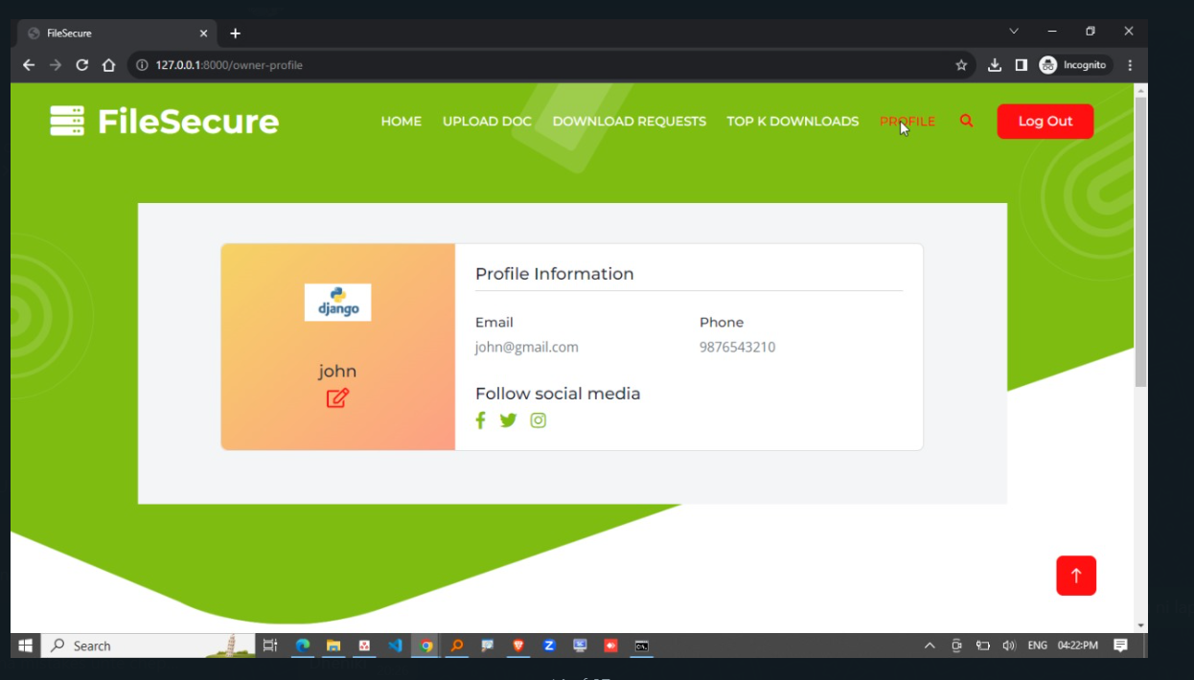

Slide 28
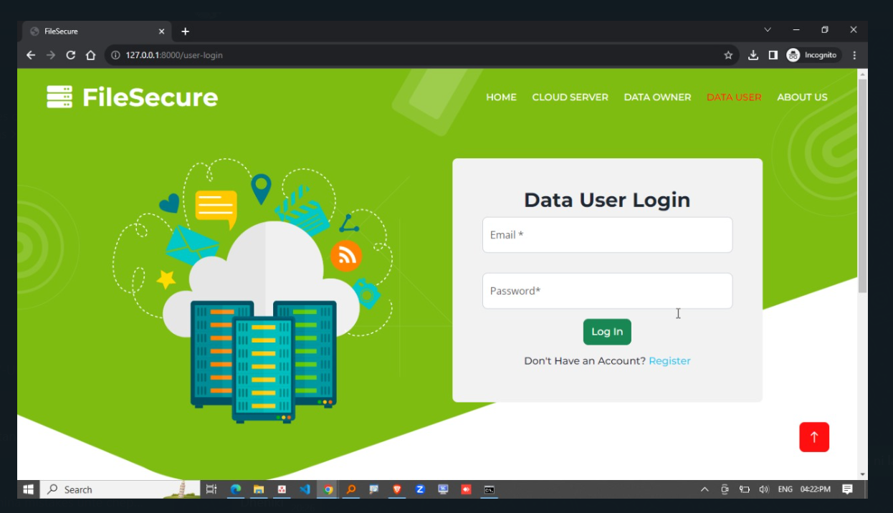

Slide 29
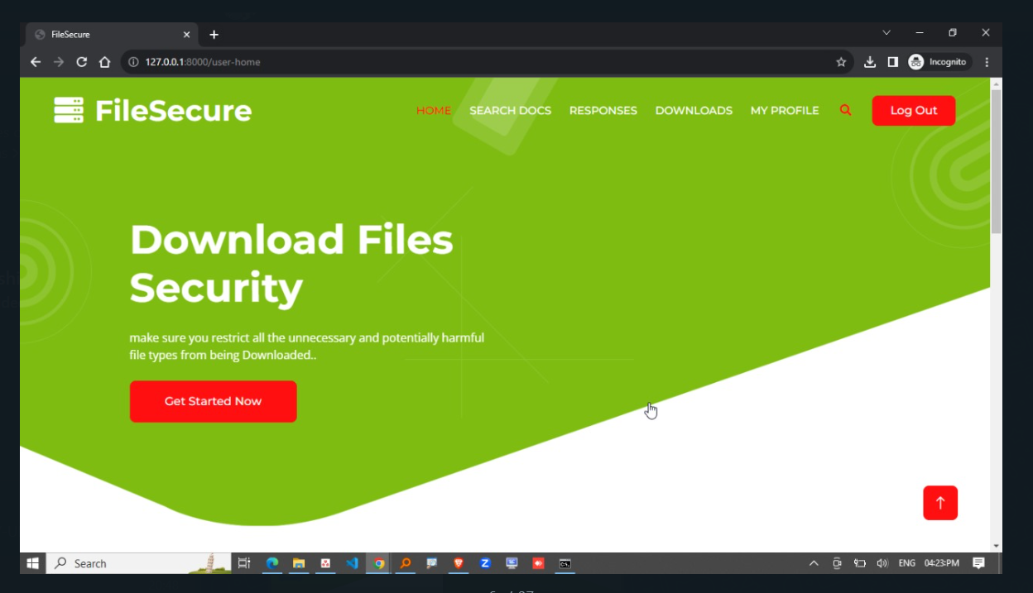

Slide 30
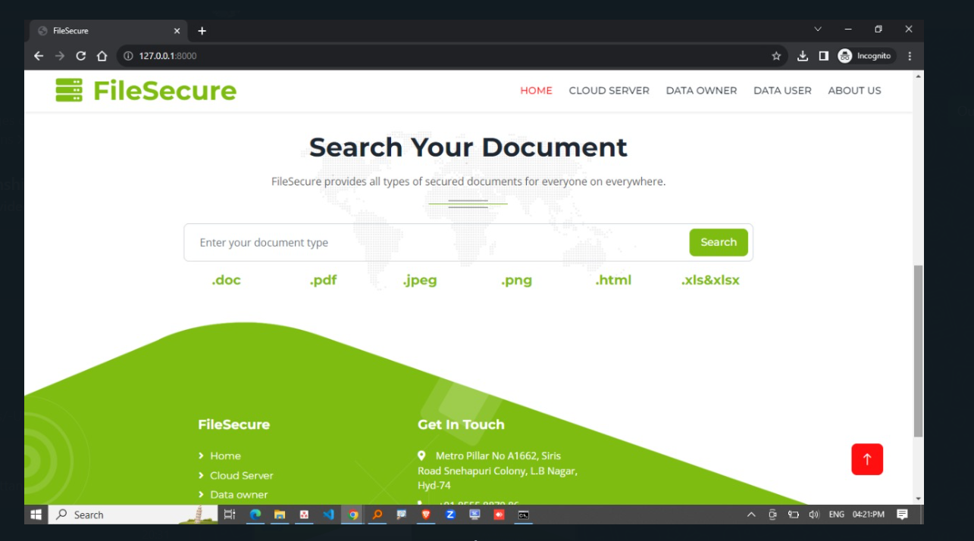

Slide 31
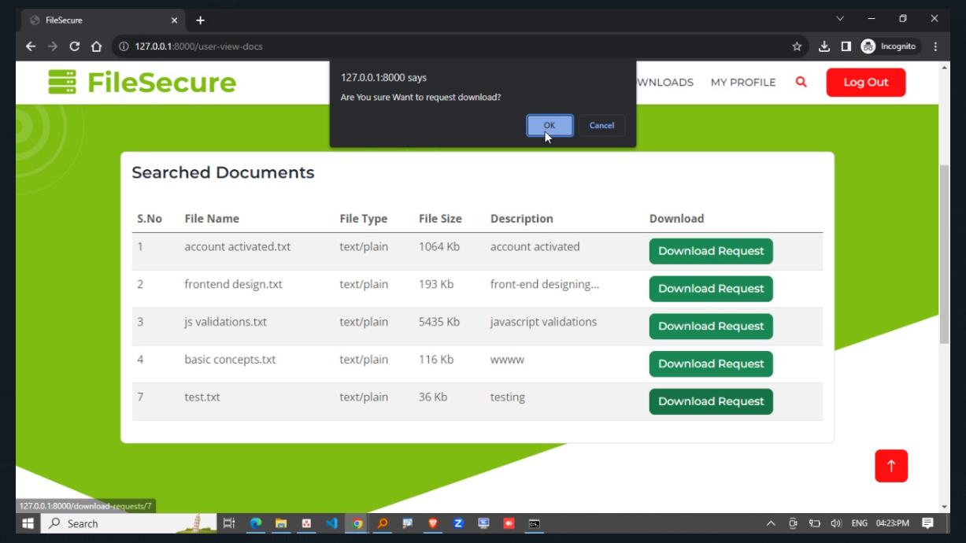

Slide 32
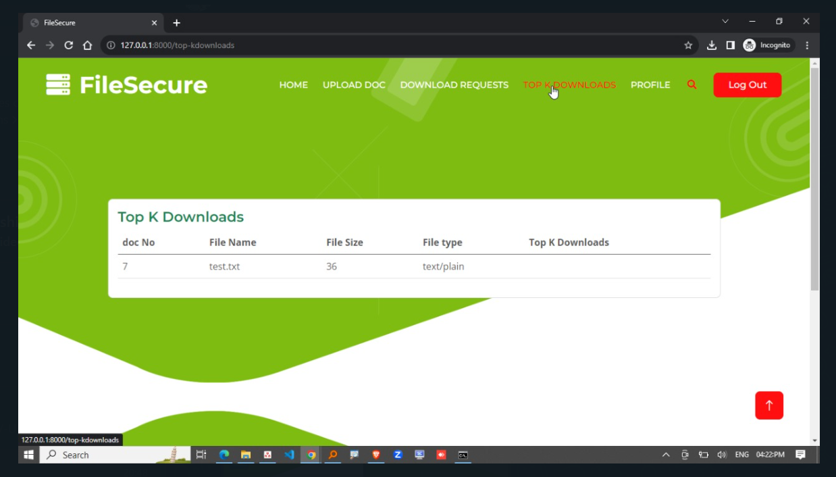

Slide 33
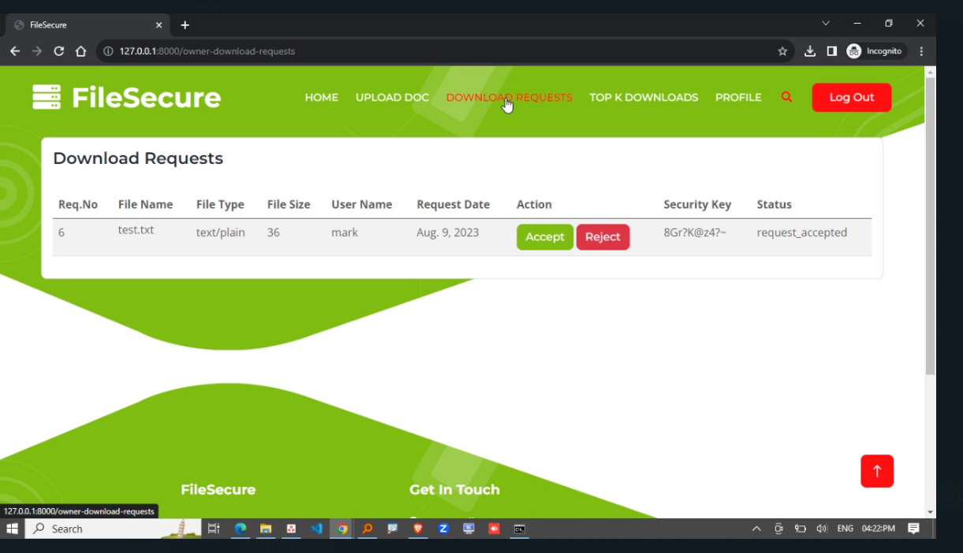

Slide 34
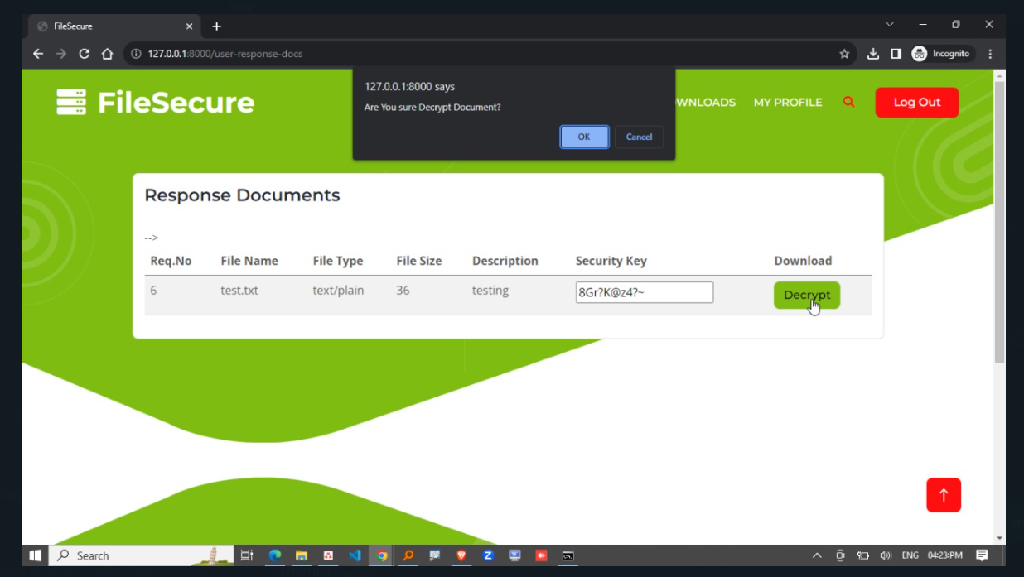

Slide 35
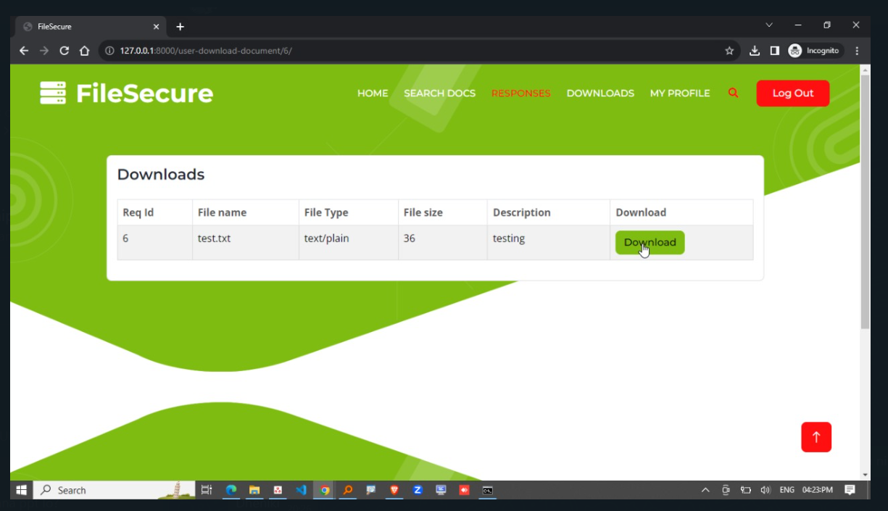

Slide 36
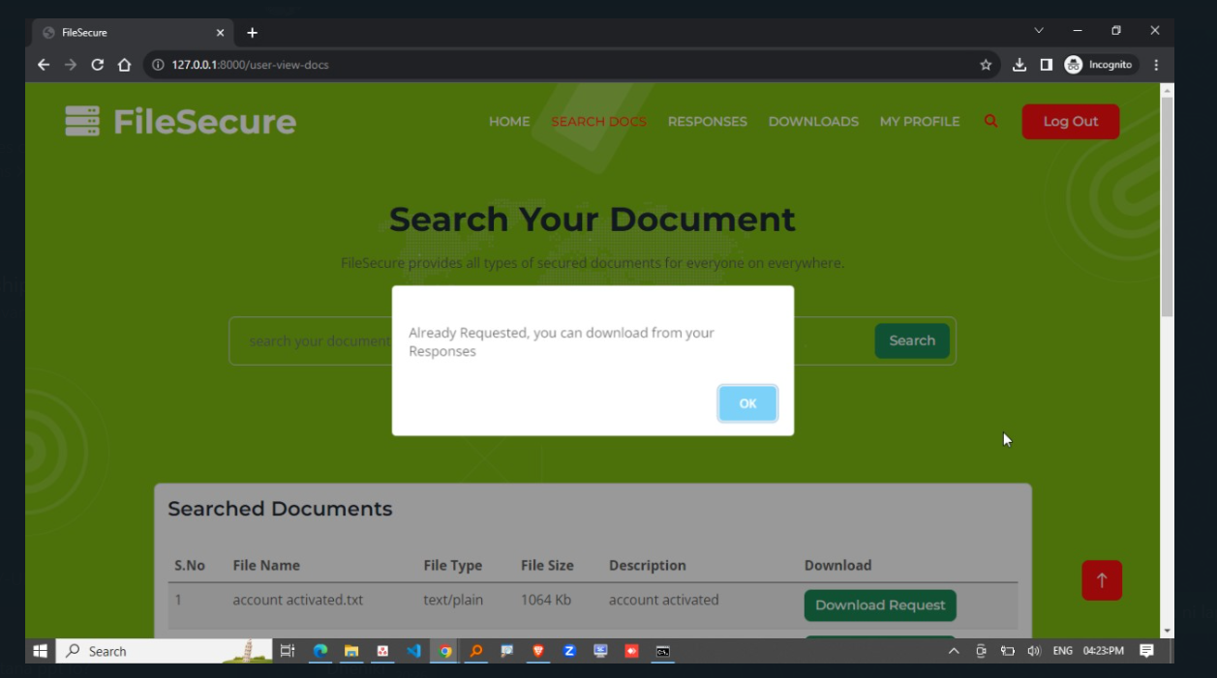

Slide 37
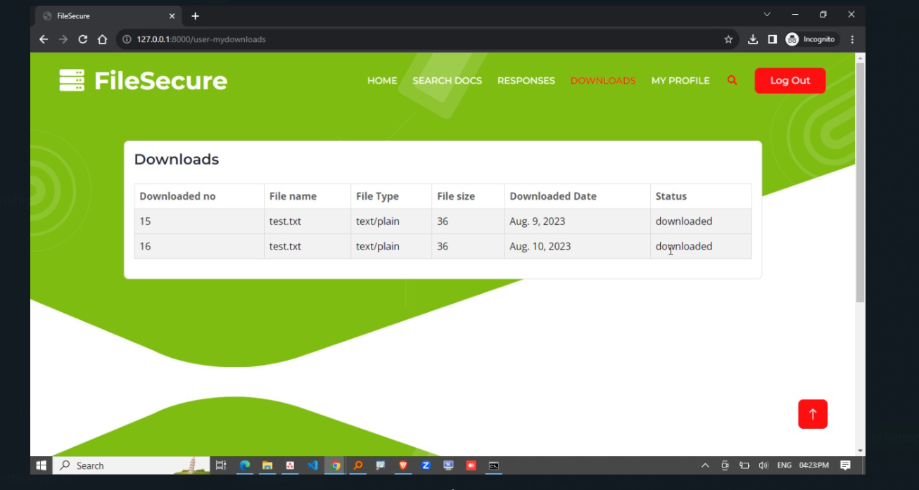

Slide 38
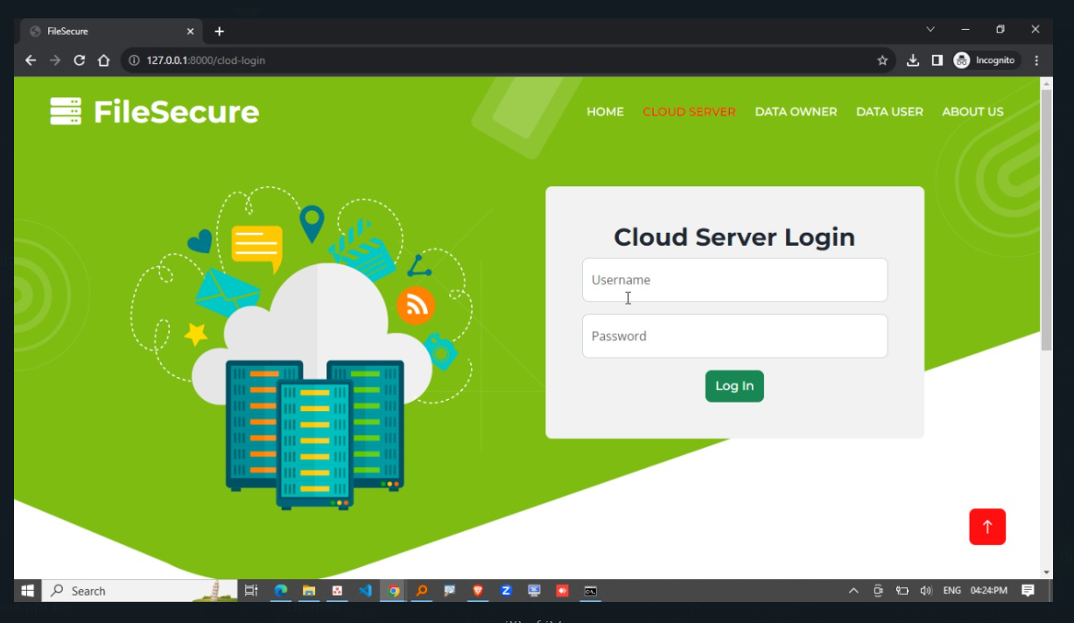

Slide 39
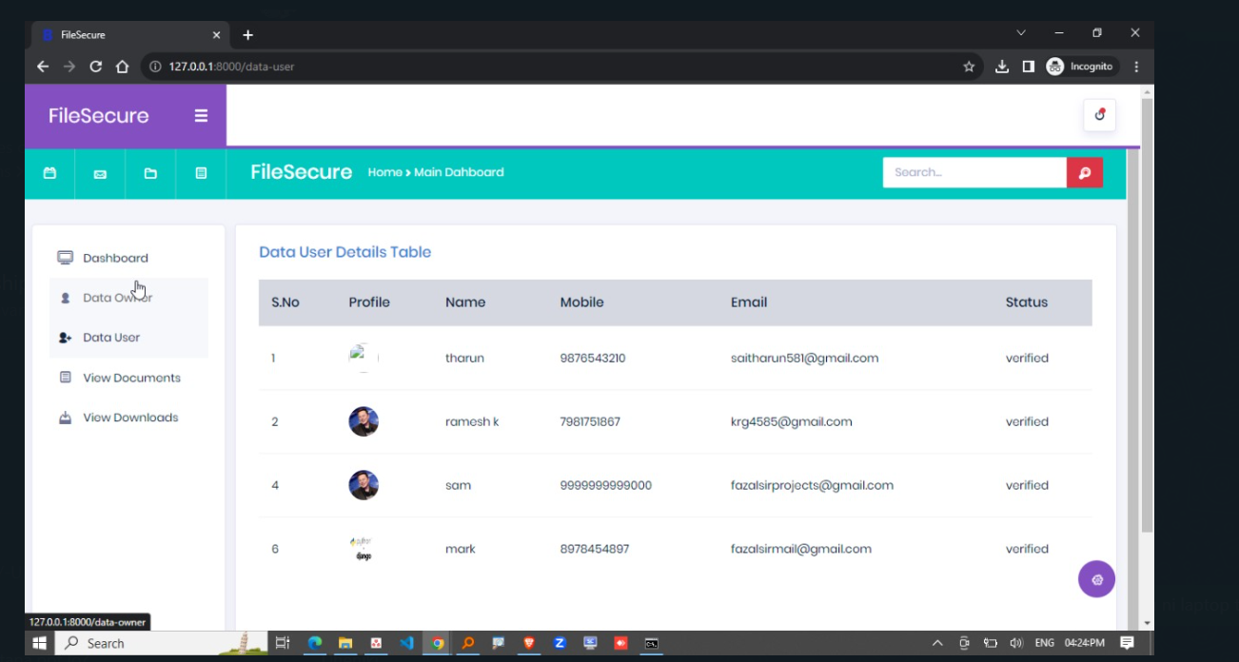

Slide 40
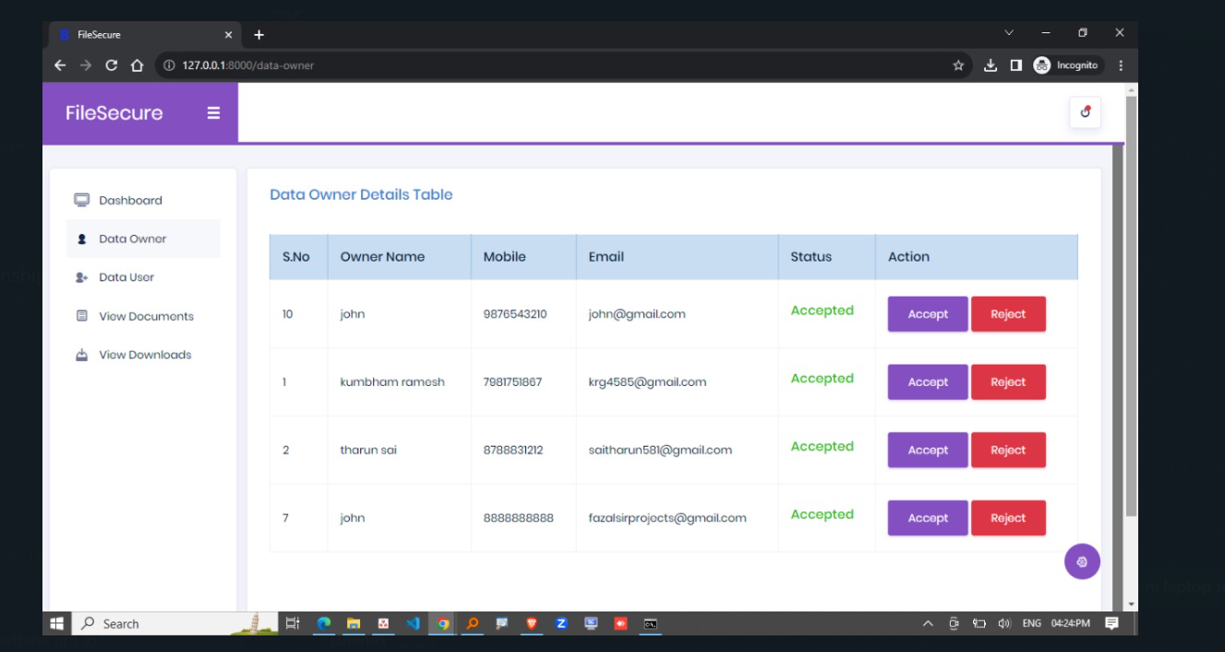

Slide 41
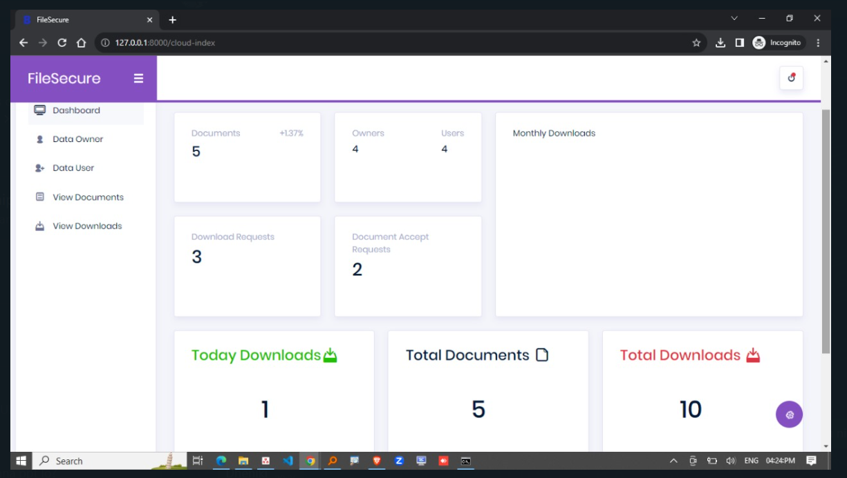

Slide 42
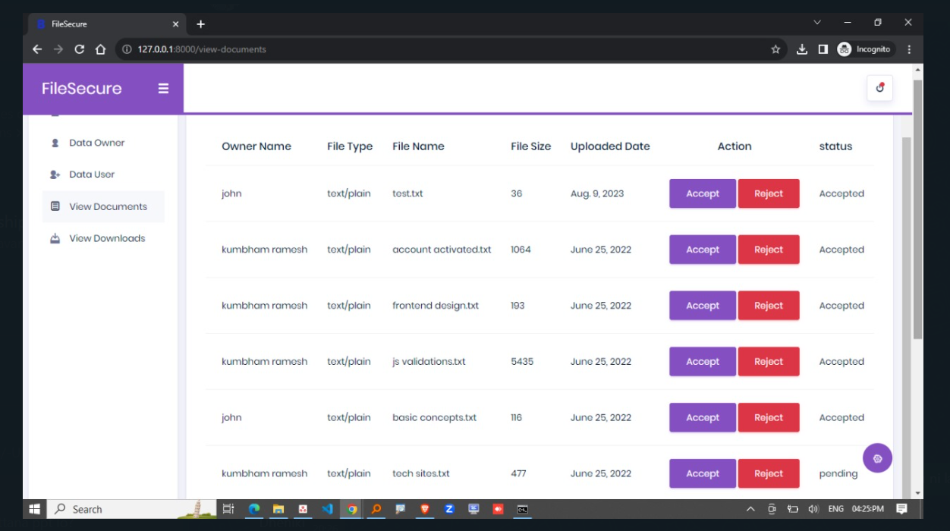

Slide 43
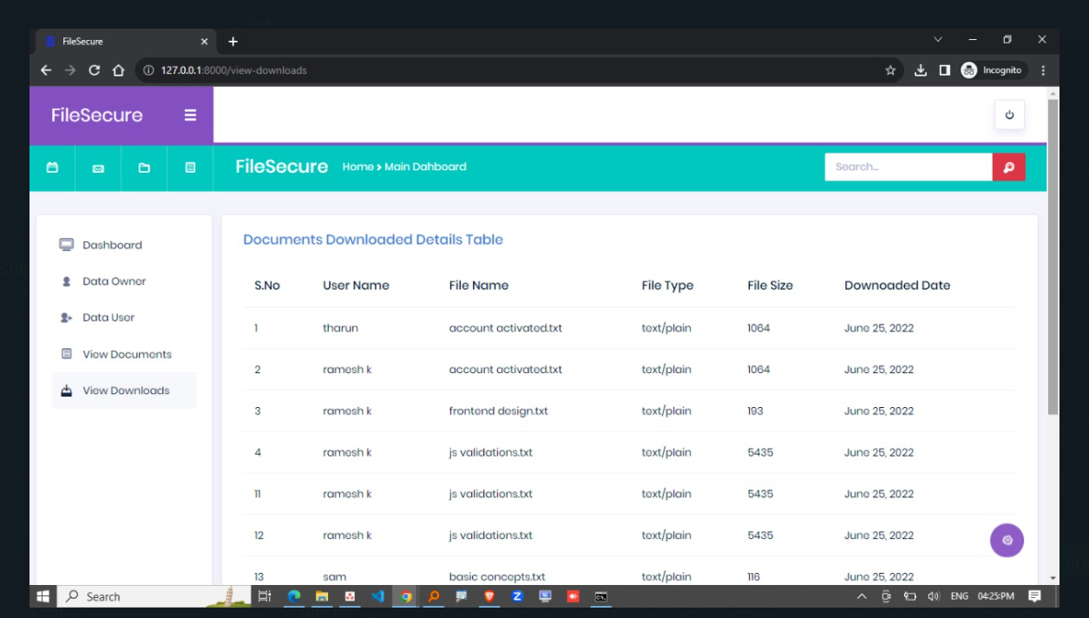

Slide 44
REFERENCES
Z. Wan and R. H. Deng, ‘‘VPSearch: Achieving verifiability for privacypreserving multi-keyword search over encrypted cloud data,’’ IEEE Trans. Depend. Secure Comput., vol. 15, no. 6, pp. 1083–1095, Nov./Dec. 2016.
Y. Yang, H. Lin, X. Liu, W. Guo, X. Zheng, and Z. Liu, ‘‘Blockchainbased verifiable multi-keyword ranked search on encrypted cloud with fair payment,’’ IEEE Access, vol. 7, pp. 140818–140832, 2019.
N. Cao, C. Wang, M. Li, K. Ren, and W. Lou, ‘‘Privacy-preserving multikeyword ranked search over encrypted cloud data,’’ in Proc. IEEE INFOCOM, Apr. 2011, pp. 829–837.
W. K. Wong, D. W.-L. Cheung, B. Kao, and N. Mamoulis, ‘‘Secure kNN computation on encrypted databases,’’ in Proc. ACM SIGMOD Int. Conf. Manage. Data, Jun. 2009, pp. 139–152.
Z. Fu, X. Sun, Q. Liu, L. Zhou, and J. Shu, ‘‘Achieving efficient cloud search services: Multi-keyword ranked search over encrypted cloud data supporting parallel computing,’’ IEICE Trans. Commun., vol. E98.B, no. 1, pp. 190–200, 2015.

